Slide 1
Graph Theory and Connectivity

Slide 2
What is a graph?
Edges
Nodes
Notes:
Before I really get into this lecture, I want to spend a couple slides really defining WHAT a graph is for you guys. Here’s the components.

Slide 3
Different types of graphs
Directed
Weighted
Boccaletti et al. 2006
Notes:
Here’s the varying complexities (basic, directed, weighted). Note that complexity deals only with the edges; the nodes are of fixed complexity.

Slide 4
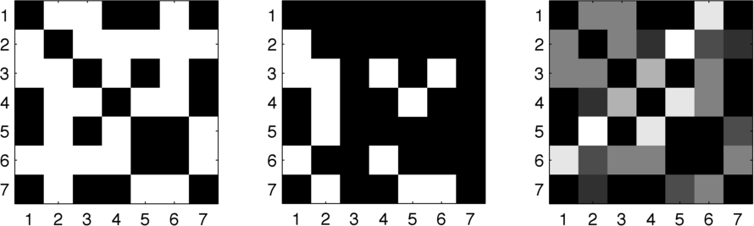
Matrix Form
Notes:
And here’s alternative ways to represent graphs in a manner amenable to MATLAB.
Note that properties of graphs translate to properties of matrices (namely, symmetry and binariness)

Slide 5
Why do we care about graphs?
Our neuroscientist half:
Assess connections among networks of neurons
Our computational half:
Visualize and solve difficult computational problems
Focus of today will be on the former
Notes:
Now we know what a graph is. Let’s step back. Why do we care?

Slide 6
Neurons are Connected
We know how to characterize neural responses in isolation
STA
Information Theory
“Noise Correlations”
Notes:
So far in the class, we have focused on methods that analyze neurons either as single units or as independently functioning units.
STA reconstructed receptive fields for single neurons
Information theory looked at per-neuron information and made some assumptions of independence to determine network information
And in that context, we briefly touched on “noise correlations”, which are correlations arising from connectivity and which we lament for messing with our information metrics!
HOWEVER

Slide 7
Neurons are Connected
Neurons are not isolated
Neurons are connected
Neural connections are probably functionally important

Slide 8
Neurons are Connected
How to measure neural connectivity?
Anatomical Connectivity
Effective Connectivity
Functional Connectivity
Notes:
So when we speak of “connected”, what do we mean by that? There’s three main ways we quantify connectivity:
Anatomical: static, physical synapses
Effective: mechanistic, causal relationship between unit activity (often via directly measured electrophysiological I/O properties)
Functional: purely correlation of activity

Slide 9
Anatomical Connectivity
Bock et al. 2011
Notes:
0.5x0.5x0.33 tall rectangle of cortex (layers 1, 2/3 and a little of 4). Mouse primary visual cortex. These neurons are functionally characterized with 2-photon imaging of calcium sensitive dye (orientation tuning curves, right). Then they densely reconstruct every neuron in a 3D cube by EM of thin slices. Figure A shows rendering of a bunch of neurons (colored balls), but only three relevant ones. Figures B and C show how synapses were characterized (note the postsynaptic densities), which are in turn marked with yellow dots in Figure A.

Slide 10
Anatomical Connectivity
Briggman et al. 2011
Notes:
Anatomical connections between direction selective ganglion cells (DSGCs) and inhibitory starburst amacrine cells (SACs) of the retina. SACs respond maximally to centrifugal motion, which in turn yields inhibition of connected DSGCs. The question is whether their connectivity could give rise to direction computations in DSGCs.
DGSCs were functionally characterized using 2-photon optical imaging, similar to the last figure. SACs anatomically by their characteristic patterns.
Top figures show SEM images. A-B are real synapses, C-D are non-real synapses, E is them jerking it to the fact that SEM resolution can catch the separation whereas optical techniques cannot.
The bottom figure shows connectivity of differently-tuned DSGCs to the dendritic varicosities to the SAC. The idea is that the SAC is at the center of four direction-selective DSGC units, and a stimulus moving across that DSGC such that it produces centripetal motion in the SAC gives rise to uninhibited excitation, thereby direction selectivity.
You should notice that anatomical connectivity generally isn’t great on its own, and needs some sort of functional measure to accompany it. However, anatomical connectivity generally deals with large volumes very well.

Slide 11
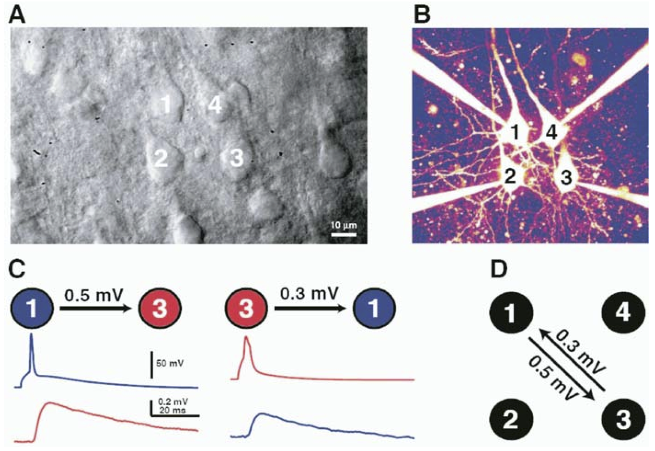
Effective Connectivity
Song et al 2005
Notes:
Paper you all have to read
Basically, patch 4 cells at once
Stimulate 1 neuron, assess the resultant peak of the EPSP in the putatively connected neuron
Bottom-right corner is a graph (which we’ll get to) depicting directed connection weights based on EPSP peak
Effective connectivity is nice, but generally can only be done for a very small network

Slide 12
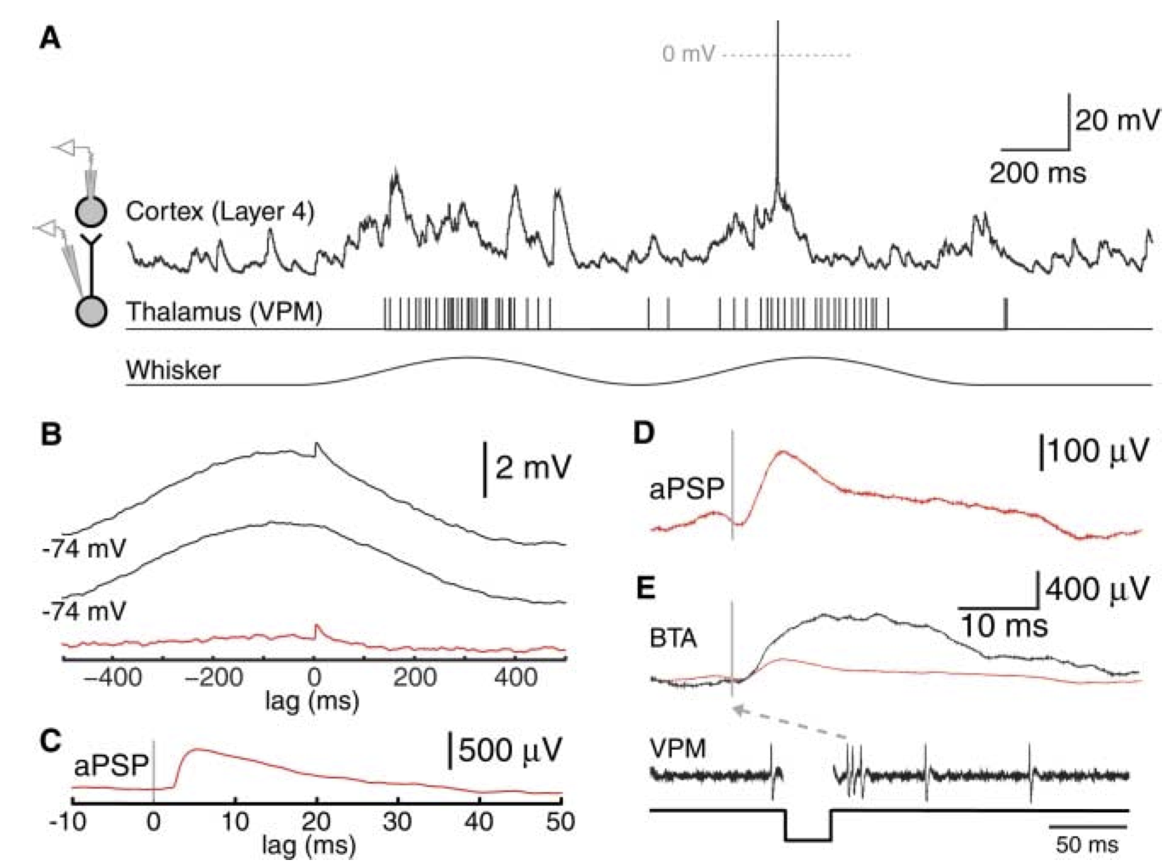
Effective/Functional Connectivity
Bruno and Sakmann 2006
Notes:
Rat S1 during whisker stimulation
Layer 4 barrel (i-cell)
VPM single unit (e-cell)
aPSP = average post-synaptic potential
STA of Vm before and after the spike. To get the lower trace in B, they shuffle their thalamus and cortex readings across trials. Subtraction in B (STA – stimulus-induced correlation) gets the red trace, i.e., aPSP.

Slide 13
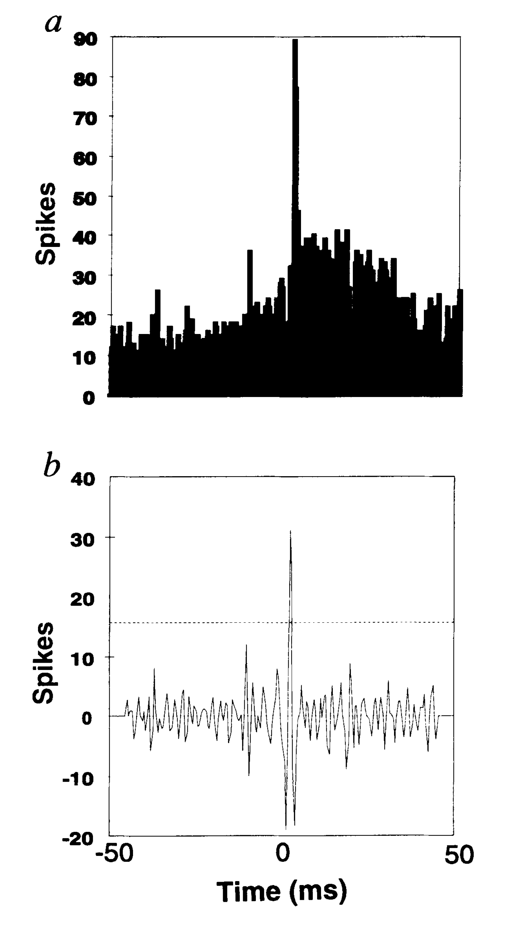
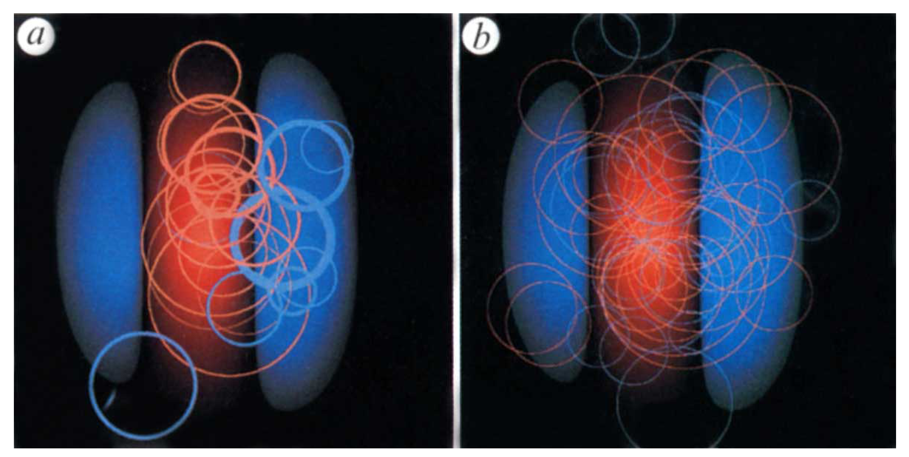
Functional Connectivity
Reid and Alonso1995
Notes:
Bottom (b) is demeaned PSTH

Slide 14
Now what?
Consider neurons as nodes and synapses as edges
Connectivity measures dictate edge
Locations
Directedness
Weights

Slide 15
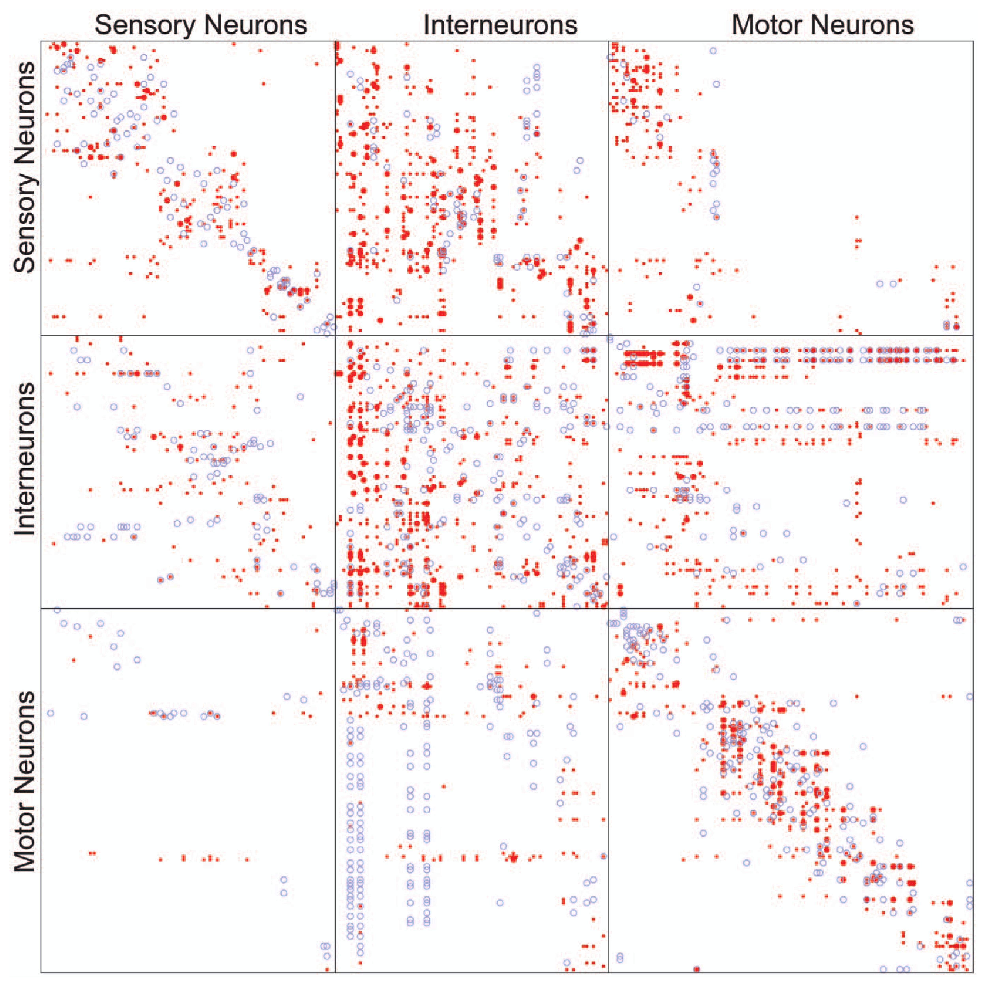
C elegans adjacency matrix
Varshney et al. 2011
Notes:
Connectivity matrix based on gap junction work in C elegans
Colors = excitatory/inhibitory, also larger symbols = more junction sites
What type of graph is this? (weighted and directed)

Slide 16
Now what?
We need priors to make interpretations of our graphs meaningful
We need summary measures to describe big networks in the first place

Slide 17
Graph Priors
Random (Erdős–Rényi) Graphs
Regular Graphs
Small-World Graphs

Slide 18
Random Graphs
Defined by a uniform, independent connection probability between any two nodes
Watts and Strogatz 1996

Slide 19
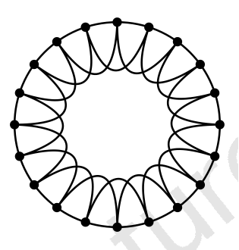
Regular Graphs
Deterministic edge distributions
Often determined by Euclidian distance
Watts and Strogatz 1996

Slide 20
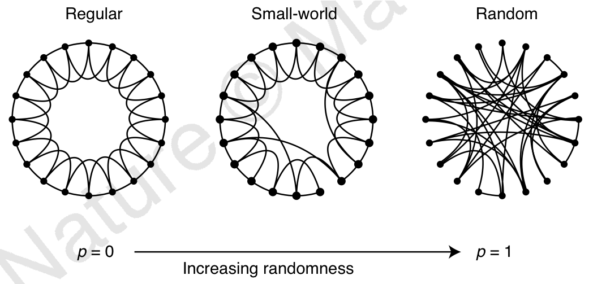
Small-World Graphs
Generate regular graph
Randomly shuffle edge connections from a subset of nodes
Determined by uniform shuffling probability
Watts and Strogatz 1996

Slide 21
Graph measures
Motif frequencies
Clustering coefficient
Characteristic path length
Degree distribution

Slide 22
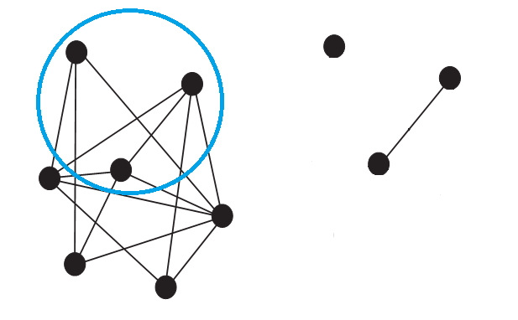
Motif Frequencies
Subgraph: A subset of nodes & their connected edges lifted from a larger graph
Notes:
When a graph is too large and you just want to analyze statistics of snippets

Slide 23
Motif Frequencies
Analyze the likelihood of all possible N-sized subgraphs
Usually compared against random priors
Song et al. 2005

Slide 24
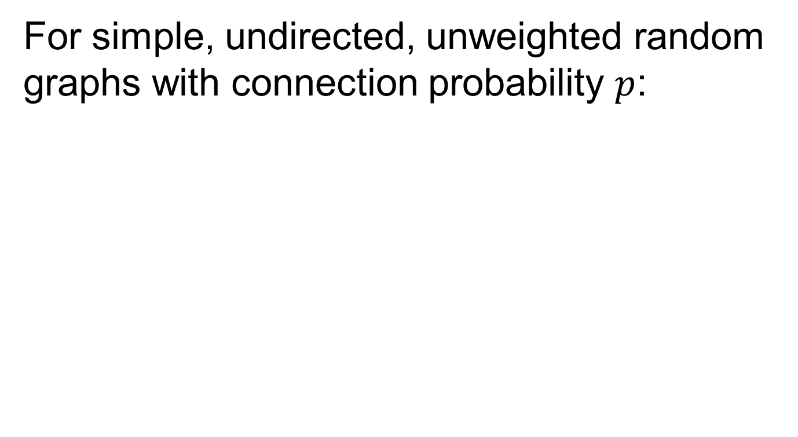
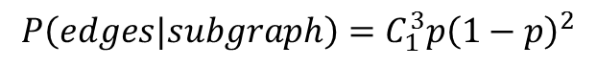
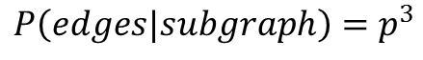
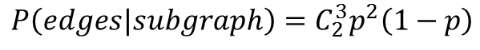
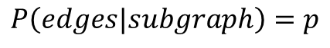
Motifs: Random Prior
For simple, undirected, unweighted random graphs with connection probability $p$:
$$P\left(edges|subgraph\right)=p$$
$$P\left(edges|subgraph\right)=p^{3}$$
$$P\left(edges|subgraph\right)=C_{2}^{3}p^{2}\left(1−p\right)$$
$$P\left(edges|subgraph\right)=C_{1}^{3}{p\left(1−p\right)}^{2}$$

Slide 25
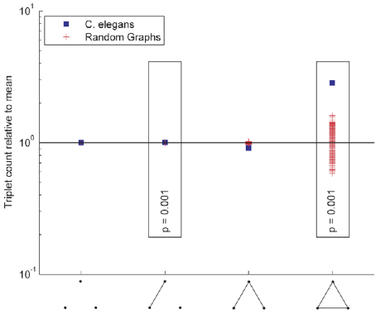
Motifs: C elegans vs. Random
Varshney et al. 2011
Notes:
Data from the gap junction network in C elegans.
Compares likelihood of motifs against some prior (in this case, random graph)

Slide 26
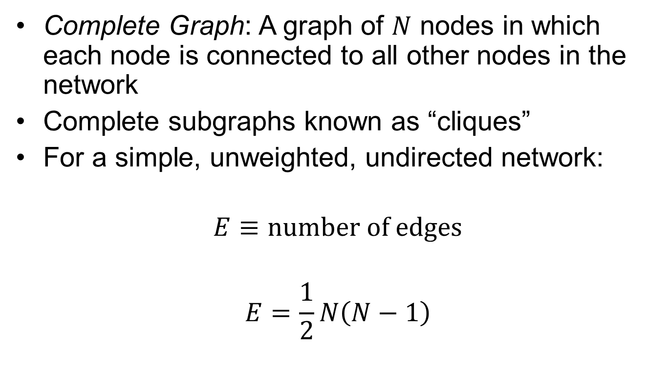
Clustering Coefficient
Complete Graph: A graph of $N$ nodes in which each node is connected to all other nodes in the network
Complete subgraphs known as “cliques”
For a simple, unweighted, undirected network:
$$E≡number of edges$$
$$E=\frac{1}{2}N\left(N−1\right)$$

Slide 27
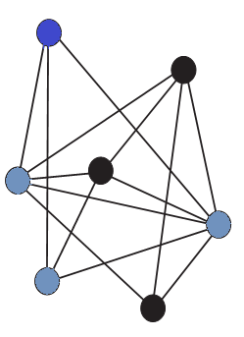
Clustering Coefficient
Neighborhood: For some node, the subgraph of all nodes connected to it.

Slide 28
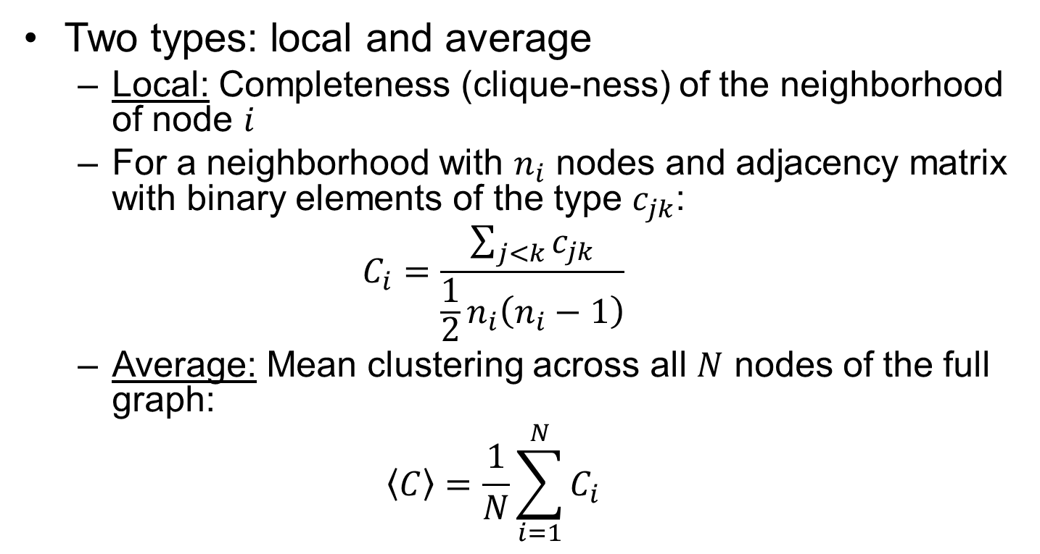
Clustering Coefficient
Two types: local and average
Local: Completeness (clique-ness) of the neighborhood of node $i$
For a neighborhood with $n_{i}$ nodes and adjacency matrix with binary elements of the type $c_{jk}$:
$$C_{i}=\frac{\sum_{j<k}{c_{jk}}}{\frac{1}{2}n_{i}\left(n_{i}−1\right)}$$
Average: Mean clustering across all $N$ nodes of the full graph:
$$\left\langle C\right\rangle =\frac{1}{N}\sum_{i=1}^{N}{C_{i}}$$

Slide 29
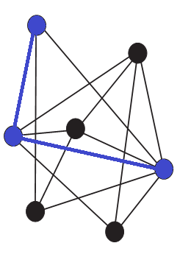
Characteristic Path Length
Path: Alternating sequence of edges and nodes, beginning and terminating with a node
Path Length: Sum of edge weights in a path

Slide 30
Characteristic Path Length
Minimum Path Length: For a given pair of nodes, the minimum edge count among all possible paths
Solved using Dijkstra's algorithm
Notes:
DYKE-stra
oh god it’s still horrible

Slide 31
Minimum Path Length Solution
function Li = Dijkstra(A,i)
% Takes adjacency matrix A, starting node index i
% mark non-existent edges as having weights of inf
% Li gives the minimum distance to each node
% for directed graphs, columns dictate the "from" node
n = size(A,1); % node count
Li = inf(n,1); % distance functions initialized to inf
Li(i) = 0; % starting point w/0 dist by definition
uv = 1:n; % indices of unvisited nodes
while any(uv)
[~,ci] = min(Li(uv)); % find terminal index of shortest path
current = uv(ci); % greedily mark as "current"
uv(ci) = []; % ...and, in turn, as "visited"
Li(uv) = min(Li(uv),Li(current) + A(uv,current));
% minimum of previous distance & current
end

Slide 32
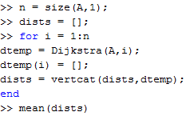
Characteristic Path Length
Characteristic Path Length: The mean minimum path length across all pairs of (different) nodes:

Slide 33
L and C of prior graphs
Regular: L ~ N C ~ 1
Random: L ~ log N C ~ 1/N
Small World: L ~ log N C ~ 1
Watts and Strogatz 1996

Slide 34
L and C of prior graphs
Regular: L ~ N C ~ 1
Random: L ~ log N C ~ 1/N
Small World: L ~ log N C ~ 1
Watts and Strogatz 1996
Notes:
See here: you get the path length of a random network without sacrificing the clustering of a regular network

Slide 35
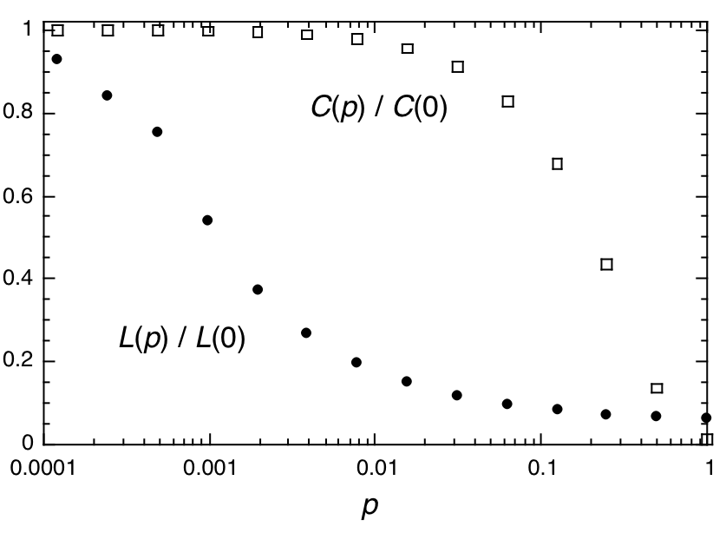
“Sweet Spot”
Notes:
Note that as you become more random, L drops off way faster than C
Therefore, you have a “sweet spot” in which real networks reside

Slide 36
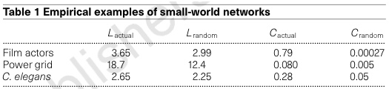
Real Networks in the “Sweet Spot”
N=279
Watts and Strogatz 1996
Notes:
Note the columns L_actual and C_actual vs L_random and C_random. Real networks have both.

Slide 37
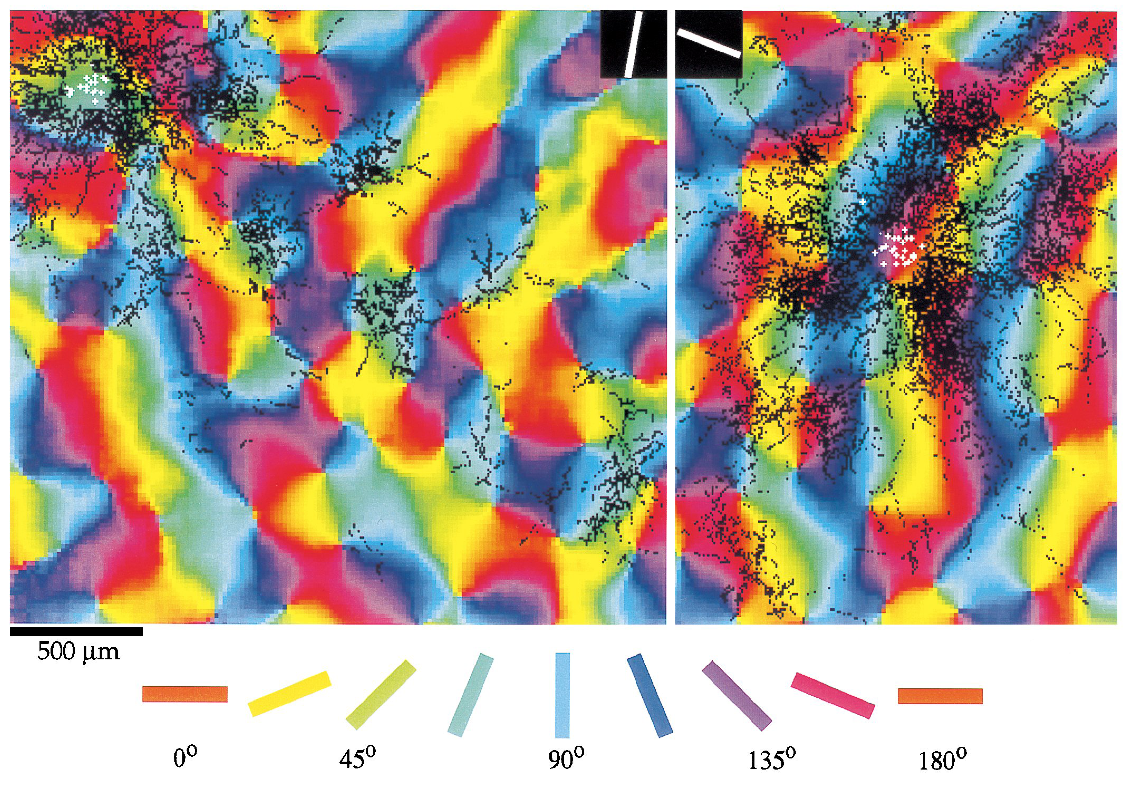
Tree Shrew Small World
Bosking et al. 1997
Notes:
Tree shrew V1
Colors are orientation columns
Black bits are all the neurons connected (ANATOMICALLY) to the white dots in these figures
Note the preferential long-range connections to neurons of similar tuning, especially for the figure on the left
The point is that regular networks assume spatial proximity is ALL that dictates connectivity, whereas small-world networks add in randomness to simulate some latent variable unknown to our naïve priors

Slide 38
Degree Distributions
The degree of a node k_{i} is simply the number of edges connected to that node
The degree distribution P(k) is the probability across a network of a node having degree k.

Slide 39
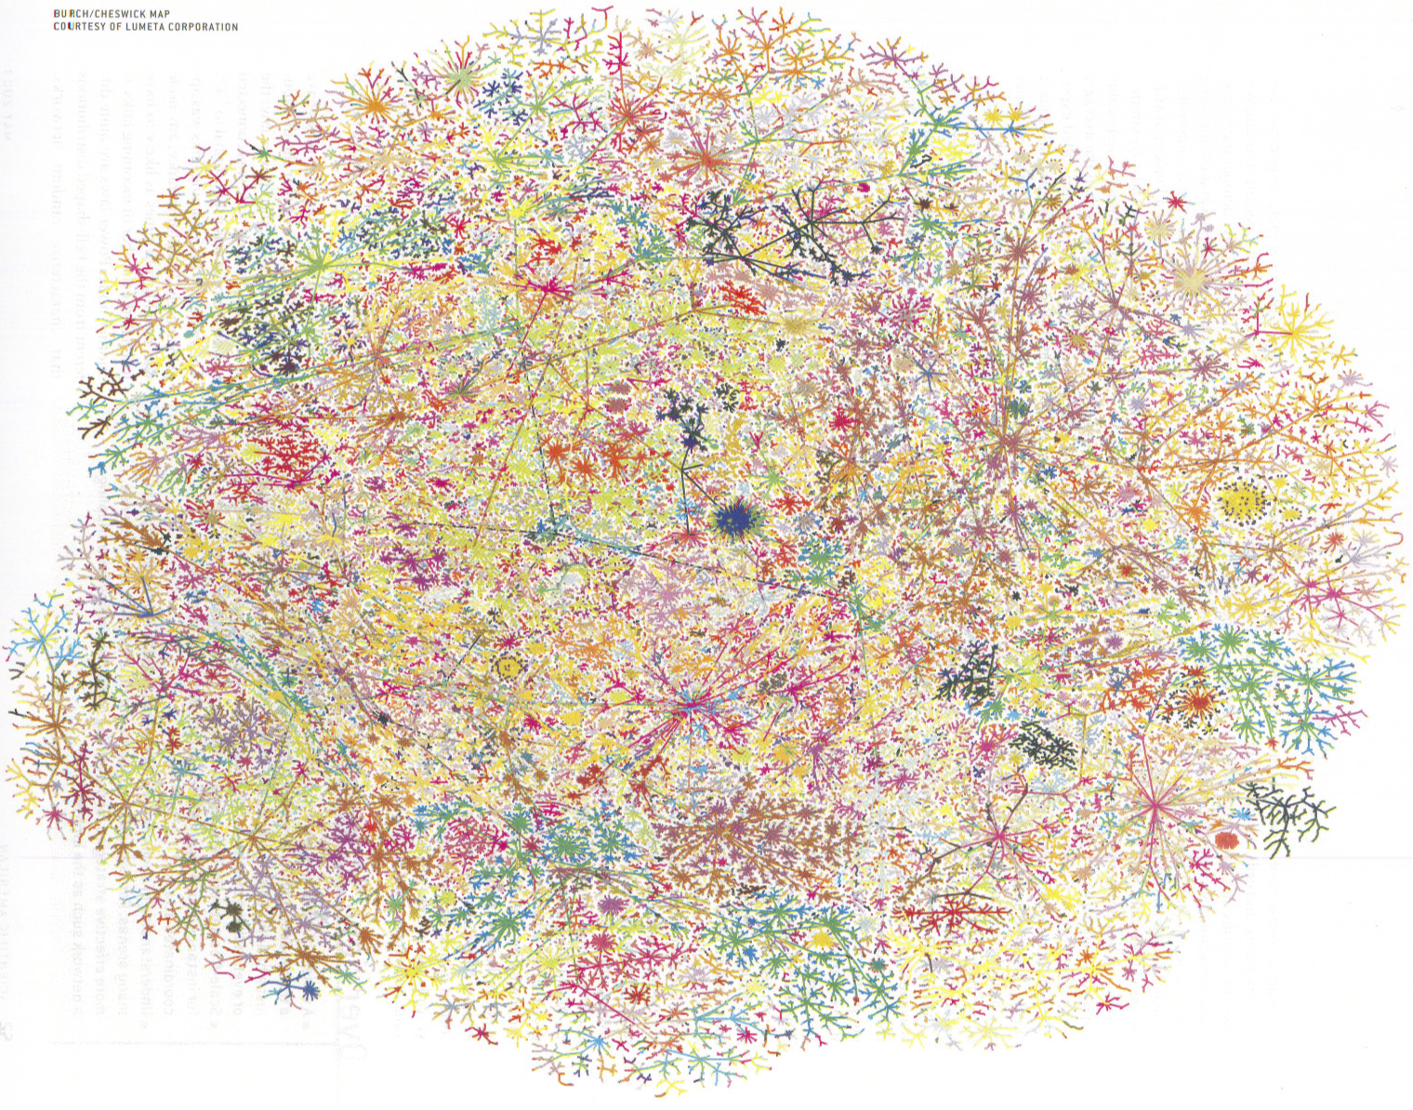
Hubs: High-Degree Nodes
Barabasi and Bonabeau 2003
Notes:
This is the internet. Note the densities: those are hubs, i.e., high-degree nodes

Slide 40
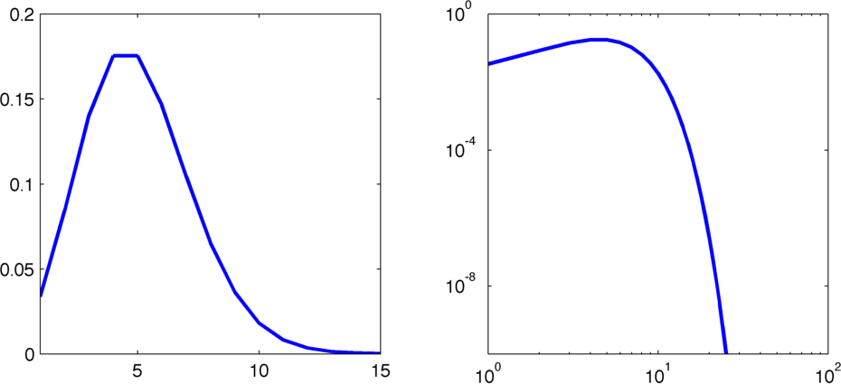
Random Networks
The degree distribution of a random network is:
P(k)
Notes:
This is just the binomial distribution.
In case you were wondering, a regular network degree distribution is just a discrete delta function.

Slide 41
Random Networks
For random networks:
P(k)
Notes:
This is a fast, exponential dropoff for highly connected nodes. Hubs are not common.

Slide 42
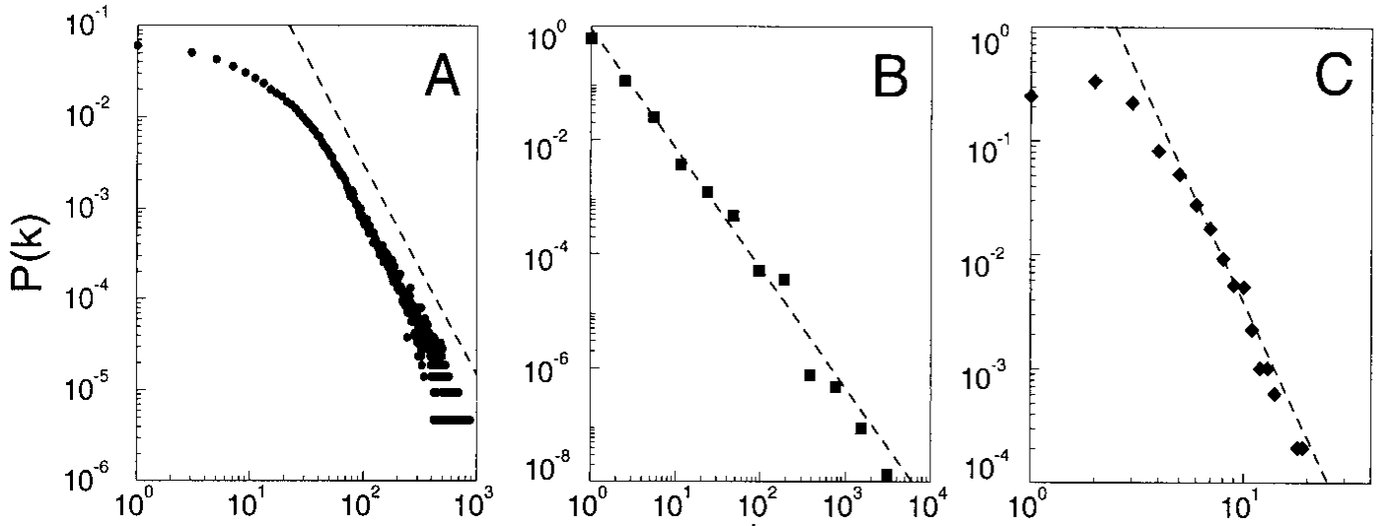
Real Networks
Actor Collaborations
World Wide Web
Power Grid
Empirically, in many real networks
Barabasi and Albert 1999
Notes:
Actor power law – exponent 2.3 . WWW power lab – exponent 2.1 . Power Grid power law - ~ 4.
In case you needed more reason to hate random networks.

Slide 43
Scale Invariance
A constant scaling of the inputs leads to a constant scaling of the outputs
Power laws lead to scale invariance
A power law degree distribution defines a ‘scale free’ network
Notes:
Generalization of “linear”
Important in that it’s “not exponential”

Slide 44
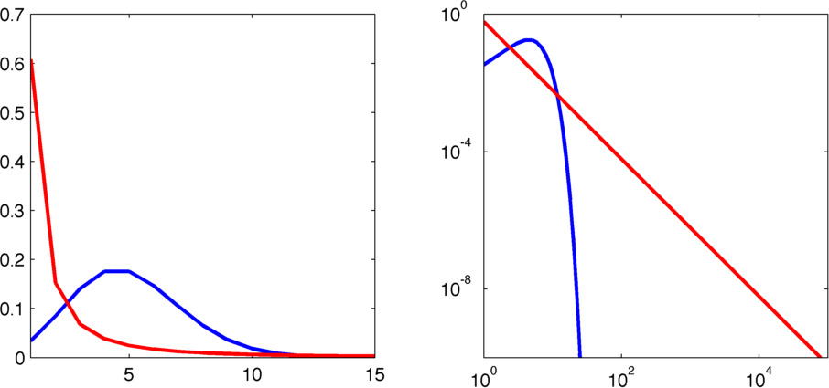
Scale Free Networks
Scale free networks have a “heavy tail”
Thus, scale free networks have hubs
P(k)
Notes:
Left plot: hard to see the hubs
Right plot: log-log plot shows the hubs

Slide 45
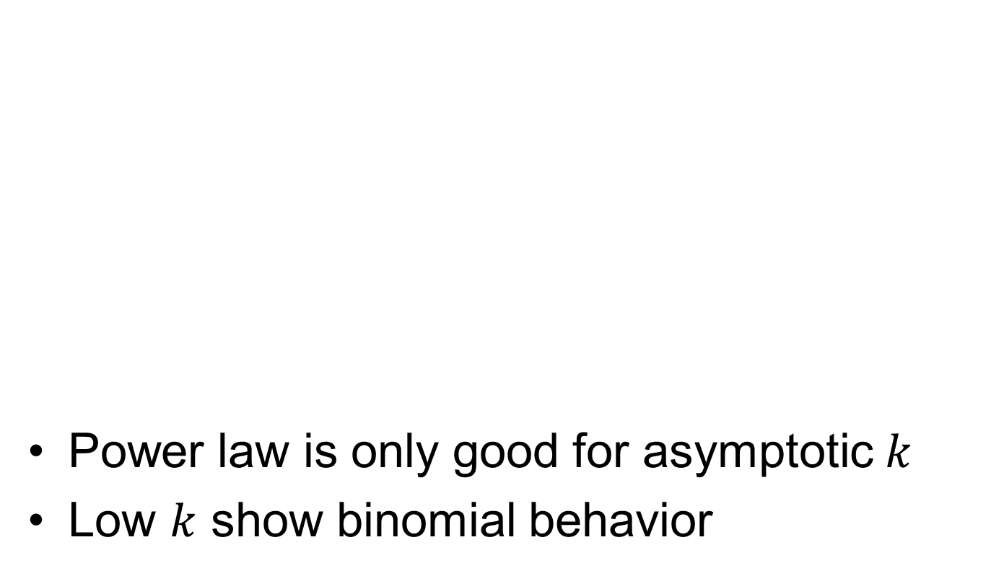
Real Networks: Low k behavior
Actor Collaborations
World Wide Web
Power Grid
Power law is only good for asymptotic $k$
Low $k$ show binomial behavior
Barabasi and Albert 1999
Notes:
Low degrees less likely than the power law approximation
Seem to follow binomial approximation better for low k
Thus, power law is only really good for explaining the likelihood of hub degrees

Slide 46
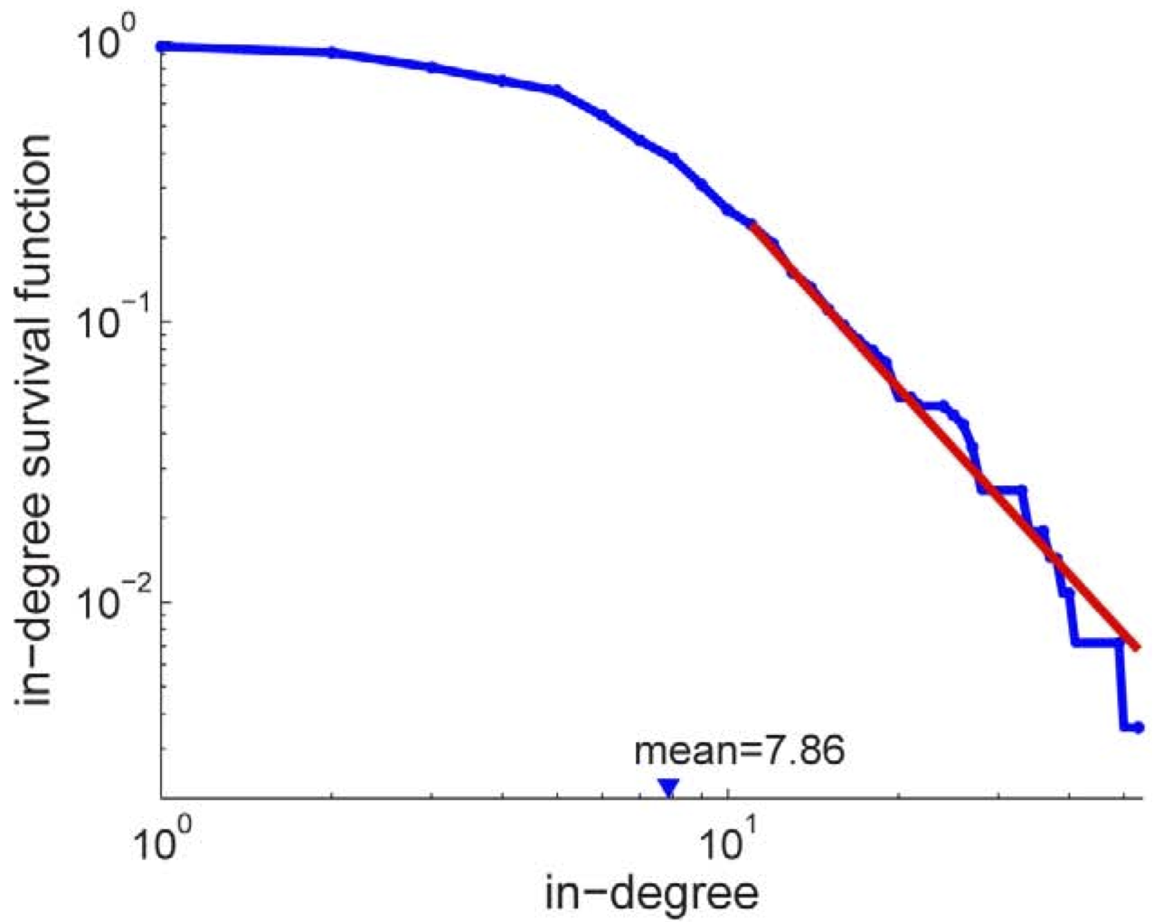
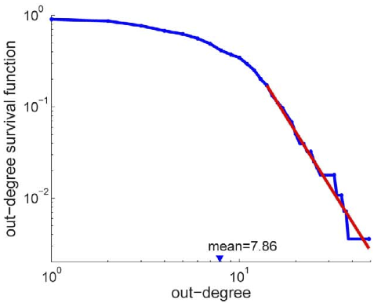
C. Elegans
Power Law Fit
Connectivity Data
γ=3.17
γ=4.22
Varshney et al. 2011
Notes:
And in case you were tired of NON-neural examples, see here how C elegans shows the same sort of behavior
Complete with both binomial low-k behavior and power law high-k behavior

Slide 47
Recap
Graphs useful for two things from our perspective
Quantifying network connectivity
Formulating problems in easily-analyzable format
Neural networks are
Clustered and connected
Have highly likely hubs
Best approximated by small-world priors: a mix of random and regular

